Slide 1
JUNIT 5
Presentation

Slide 2
JUnit5
In this Junit tutorial, we will introduce basics of JUnit5 and its new features using examples. In Java world, JUnit is one of the popular framework used to implement unit tests against java code. JUnit primarily helps developers to test their code on the JVM by themselves.

Slide 3
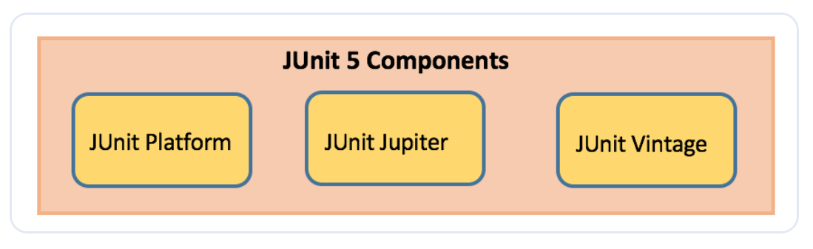
JUnit5 Architecture

Slide 4
JUnit Platform
Launches testing frameworks on the JVM
Has TestEngine API used to build a testing framework that runs on the JUnit platform

Slide 5
JUnit Jupiter
Blend of new programming model for writing tests and extension model for extensions
Addition of new annotations like @BeforeEach,@AfterEach,@AfterAll,@BeforeAll

Slide 6
JUnit Vintage
Provides support to execute previous JUnit version 3 and 4 tests on this new platform

Slide 7
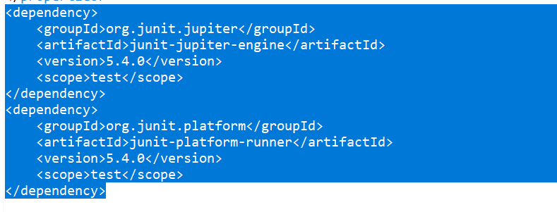
JUnit Maven Dependencies
To implement JUnit5 based test cases in a project, add the following dependency to the pom.xml file of the project:
JUnit 5 Library

Slide 8
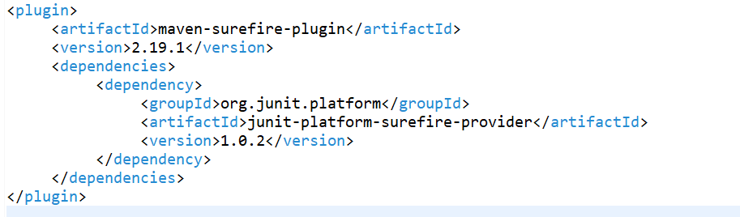
JUnit5 maven surefire provider to execute the unit tests where IDE does not have JUnit5 support (if IDE has support then this point is not required)

Slide 9
JUnit5 New Features
It requires Java 8 or higher at runtime. But one can still test code which is compiled using previous Java versions. There are various new features got introduced in it.
JUnit Annotations
Listed below are some commonly used annotations provided in it:

Slide 10
Annotation
@Test
Denotes a test method
@DisplayName
Declares a custom display name for the test class or test method
@BeforeEach
Denotes that the annotated method should be executed before each test method
@AfterEach
Denotes that the annotated method should be executed after each test method
@BeforeAll
Denotes that the annotated method should be executed before all test methods
@AfterAll
Denotes that the annotated method should be executed after all test methods
@Disable
Used to disable a test class or test method

Slide 11
@Nested
Denotes that the annotated class is a nested, non-static test class
@Tag
Declare tags for filtering tests
@ExtendWith
Register custom extensions

Slide 12
Example
package com.javaTest;
import org.junit.jupiter.api.AfterAll;
import org.junit.jupiter.api.AfterEach;
import org.junit.jupiter.api.BeforeAll;
import org.junit.jupiter.api.BeforeEach;
import org.junit.jupiter.api.Disabled;
import org.junit.jupiter.api.DisplayName;
import org.junit.jupiter.api.Test;
public class JUnit5Sample1Test {
@BeforeAll
static void beforeAll() {
System.out.println("**--- Executed once before all test methods in this class ---**");
}
@BeforeEach
void beforeEach() {
System.out.println("**--- Executed before each test method in this class ---**");
}
@Test
void testMethod1() {
System.out.println("**--- Test method1 executed ---**");
}
@DisplayName("Test method2 with condition")
@Test
void testMethod2() {
System.out.println("**--- Test method2 executed ---**");
}
@Test
@Disabled("implementation pending")
void testMethod3() {
System.out.println("**--- Test method3 executed ---**");
}
@AfterEach
void afterEach() {
System.out.println("**--- Executed after each test method in this class ---**");
}
@AfterAll
static void afterAll() {
System.out.println("**--- Executed once after all test methods in this class ---**");
}
}

Slide 13
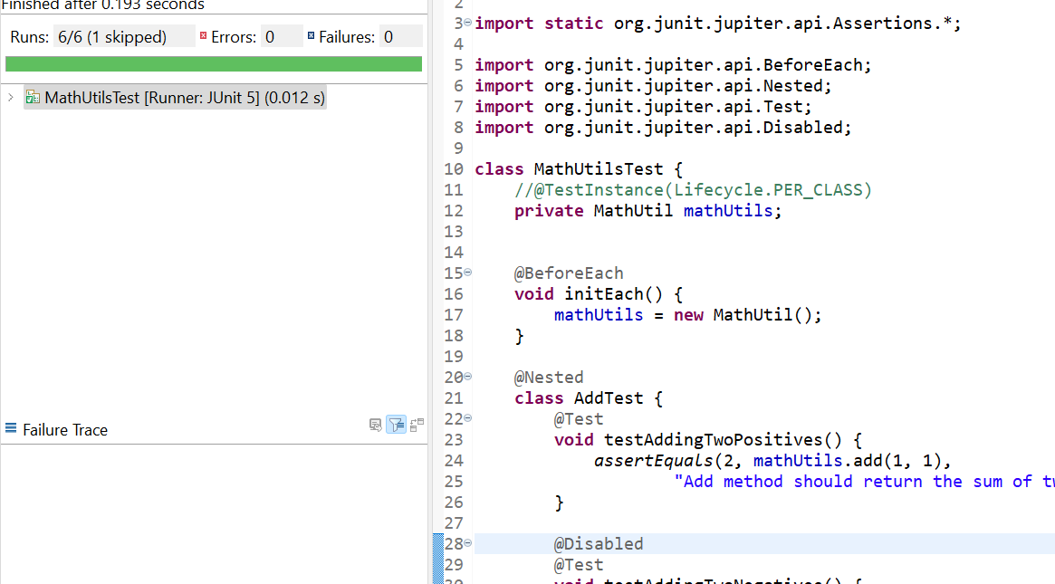
We can run above JUnit test class in Eclipse -> Run As -> JUnit Test.

Slide 14
JUnit Assertions
Every test method must be evaluated against condition to true using assertions so that the test can continue to execute. JUnit Jupiter assertions are kept in the org.junit.jupiter.api.Assertions class. All of the methods are static.

Slide 15
Assertion
assertEquals(expected, actual)
Fails when expected does not equal actual
assertFalse(expression)
Fails when expression is not false
assertNull(actual)
Fails when actual is not null
assertNotNull(actual)
Fails when actual is null
assertAll()
Group many assertions and every assertion is executed even if one or more of them fails
assertTrue(expression)
Fails if expression is not true
assertThrows()
Class to be tested is expected to throw an exception

Slide 16
Example
package io.javaTest;
import static org.junit.jupiter.api.Assertions.*;
import org.junit.jupiter.api.BeforeEach;
import org.junit.jupiter.api.Nested;
import org.junit.jupiter.api.Test;
import org.junit.jupiter.api.Disabled;
class MathUtilsTest {
//@TestInstance(Lifecycle.PER_CLASS)
private MathUtil mathUtils;
@BeforeEach
void initEach() {
mathUtils = new MathUtil();
}
@Nested
class AddTest {
@Test
void testAddingTwoPositives() {
assertEquals(2, mathUtils.add(1, 1),
"Add method should return the sum of two numbers");
}
@Disabled
@Test
void testAddingTwoNegatives() {
assertEquals(-2, mathUtils.add(-1, -1),
"Add method should return the sum of two numbers");
}
@Test
void testAddingAPositiveAndANegative() {
assertEquals(0, mathUtils.add(-1, 1),
"Add method should return the sum of two numbers");
}
}
@Test
void testMultiply() {
assertAll(
() -> assertEquals(0, mathUtils.multiply(1, 0)),
() -> assertEquals(1, mathUtils.multiply(1, 1)),
() -> assertEquals(6, mathUtils.multiply(2, 3))
);
}
@Test
void computeCircleArea() {
assertEquals(314.1592653589793, mathUtils.computeCircleArea(10),
"Should return right circle area");
}
@Test
void testDivide() {
assertThrows(ArithmeticException.class, () -> mathUtils.divide(1, 0),
"Divide should throw ArithmeticException when denominator is zero");
}
}

Slide 17
JUnit5 Imports
Its test classes need org.junit.jupiter.api.Test import statement and not org.junit.Test.
Also, the test methods need not be a public and local package.

Slide 18
JUnit5 Assumptions
Assumptions are static methods in the org.junit.jupiter.api.Assumptions class.
They will execute a test only when the specified condition met otherwise test will be aborted.
The aborted test will not cause build failure.
When an assumption fails, org.opentest4j.TestAbortedException is thrown and the test is skipped.

Slide 19
Assumptions
assumeTrue
Execute the body of lamda when the positive condition hold else test will be skipped
assumeFalse
Execute the body of lamda when the negative condition hold else test will be skipped
assumingThat
Portion of the test method will execute if an assumption holds true and everything after the lambda will execute irrespective of the assumption in assumingThat() holds

Slide 20
Example
@Test
void testAssumeTrue() {
boolean b = 'A' == 'A';
assumeTrue(b);
assertEquals("Hello", "Hello");
}
@Test
@DisplayName("test executes only on Saturday")
public void testAssumeTrueSaturday() {
LocalDateTime dt = LocalDateTime.now();
assumeTrue(dt.getDayOfWeek().getValue() == 6);
System.out.println("further code will execute only if above assumption holds true");
}

Slide 21
JUnit Nested Test Classes
Nested tests allow to create nested classes and execute all of its test methods. The inner classes must be non-static. Just annotate inner classes with @Nested and all test methods inside it will be executed.

Slide 22
Example
@Nested
class InnerMostClass {
@BeforeEach
void beforeEach() {
System.out.println("**--- InnerMostClass :: beforeEach :: Executed before each test method ---**");
}
@AfterEach
void afterEach() {
System.out.println("**--- InnerMostClass :: afterEach :: Executed after each test method ---**");
}
@Test
void testMethod2() {
System.out.println("**--- InnerMostClass :: testMethod2 :: Executed test method2 ---**");
}
}

Slide 23
JUnit Test Exception
There are situations in which methods are expected to throw an exception under a specific condition. assertThrows will fail the test if the given method does not throw the specified exception.

Slide 24
Example
Throwable exception = assertThrows(IllegalArgumentException.class, () -> {
throw new IllegalArgumentException("Illegal Argument Exception occured");
});
assertEquals("Illegal Argument Exception occured", exception.getMessage());

Slide 25
JUnit Test Execution
The unit tests can be executed in many ways, two of the ways are as follows:
Use Eclipse IDE Oxygen.3a (4.7.3a) Release and open test file to be executed. Right-click on the file and choose option Runs As followed by JUnit Test
Use mvn test command on Windows command prompt

Slide 26
Thank You

